Slide 1


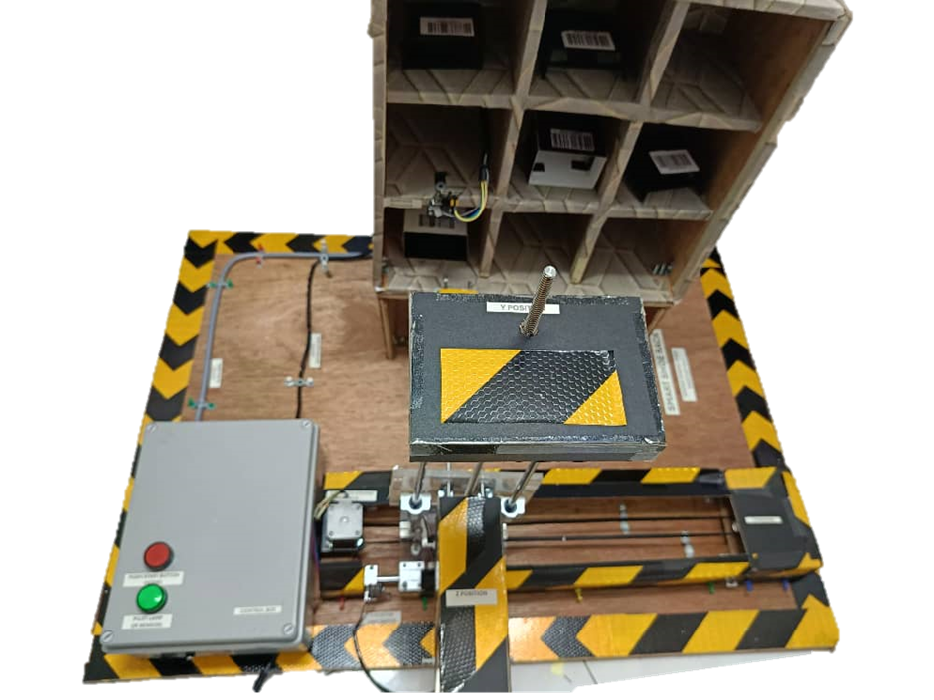

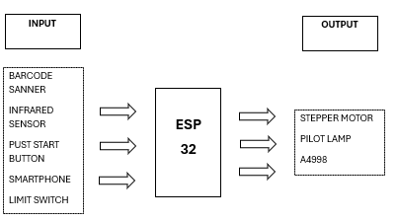
SMART SHOE RACK
Nama Pelajar:CHONG KHENG CHEN No Pendaftaran:03DET22F1043
Nama Penyelia: PUAN HABSAH BT HUSSAIN
PROJECT DESCRIPTION
Scan barcodes Attached to shoes, making it easy to identify and manage individual pairs.
Send the scanned barcode data to a google sheets database for logging and tracking shoe usage.
Utilize blynk, an iot platform, to allow remote control of the system. Users can effortlessly select which shoe to retrieve through A mobile application.
The movement of the shoe rack is controlled by stepper motors that navigate in x, y, and z directions, ensuring the selected shoe is accurately retrieved and brought down to the user.
MARKET POTENTIAL
1. Target Market
- Shoe retailers & boutiques
- Department stores with large shoe inventories
- Shoe storage solutions for shoe stores and shoe factories.
- Commercial spaces with high foot traffic (malls, airports)
2. Competitive Advantages
- Automated shoe management for efficient inventory control
- Fast, organized access to shoes for customers
- Barcode integration for easy tracking and inventory updates
PROBLEM STATEMENT
Limited storage capacity and inefficient space usage.
Difficulty in sorting and retrieving shoes, especially by style, size, or color.
Hygiene and safety concerns due to disorganized shoe placement, leading to potential falling hazards.
Manual stock management in stores is time-consuming and error-prone, often resulting in inventory issues (overstock or out-of-stock).
IMPACT PROJECT
Streamlines inventory management for commercial spaces
Automates shoe storage and retrieval
Faster, more personalized service for customers
Easy access to shoes with automated retrieval
Reduces labor costs by minimizing manual shoe handling
Improves accuracy in stock management
Enhances business automation trends
PROJECT OBJECTIVE
Modular Design: Develop a customizable shoe storage system with a unified and expandable structure, allowing users to adjust modules based on space and needs.
User-Friendly Interface: Provide a mobile app Blynk that allows users to remote control and retrieve shoes from the storage system.
Automation: Automate the process of shoe storage and retrieval using a 3x3 grid system with 2 active compartments.
Barcode Integration: Implement a barcode scanner for efficient shoe identification and placement.
IoT Control: Utilize IoT technology via Blynk for remote operation, enhancing user convenience.
PROJECT PICTURE

